Slide 1


Churn Analysis of a Telecommunication Company
Springboard Data Science Capstone Project
Presented by: Cuili Huang

Slide 2
Agenda
01
Introduction
02
Data Wrangling
03
Data Exploration
04
Machine Learning
05
Conclusion

Slide 3
01
Introduction

Slide 4

INTRODUCTION
WHAT IS CHURN ANALYSIS ?
WHO CARES ABOUT CHURN ANALYSIS?
THE USE OF CHURN ANALYSIS
Customer Retention Strategy

Slide 5
02
Data Wrangling

Slide 6
DATASET
1
Dataset acquired from Kaggle
Contains the demographic information of the customers, services subscribed, monthly payments, their tenures, etc.
2
3
Contains 21 variables and 7043 observations

Slide 7
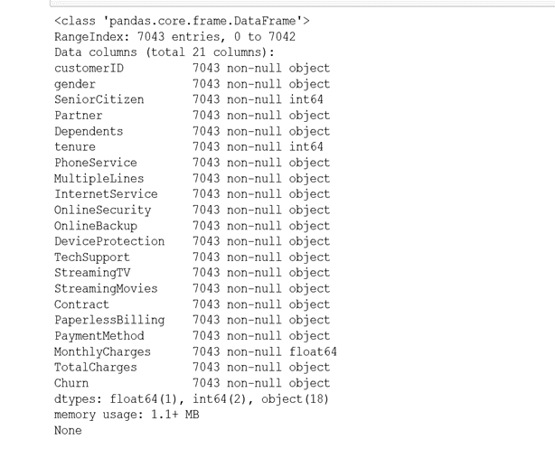

Slide 8
DATA WRANGLING
01
02
Load csv file into Pandas dataframe
Check missing values and outliers
03
04
Convert categorical features to numeric
Re-confirm data and pickle the file for next stage

Slide 9
03
Data Exploration

Slide 10
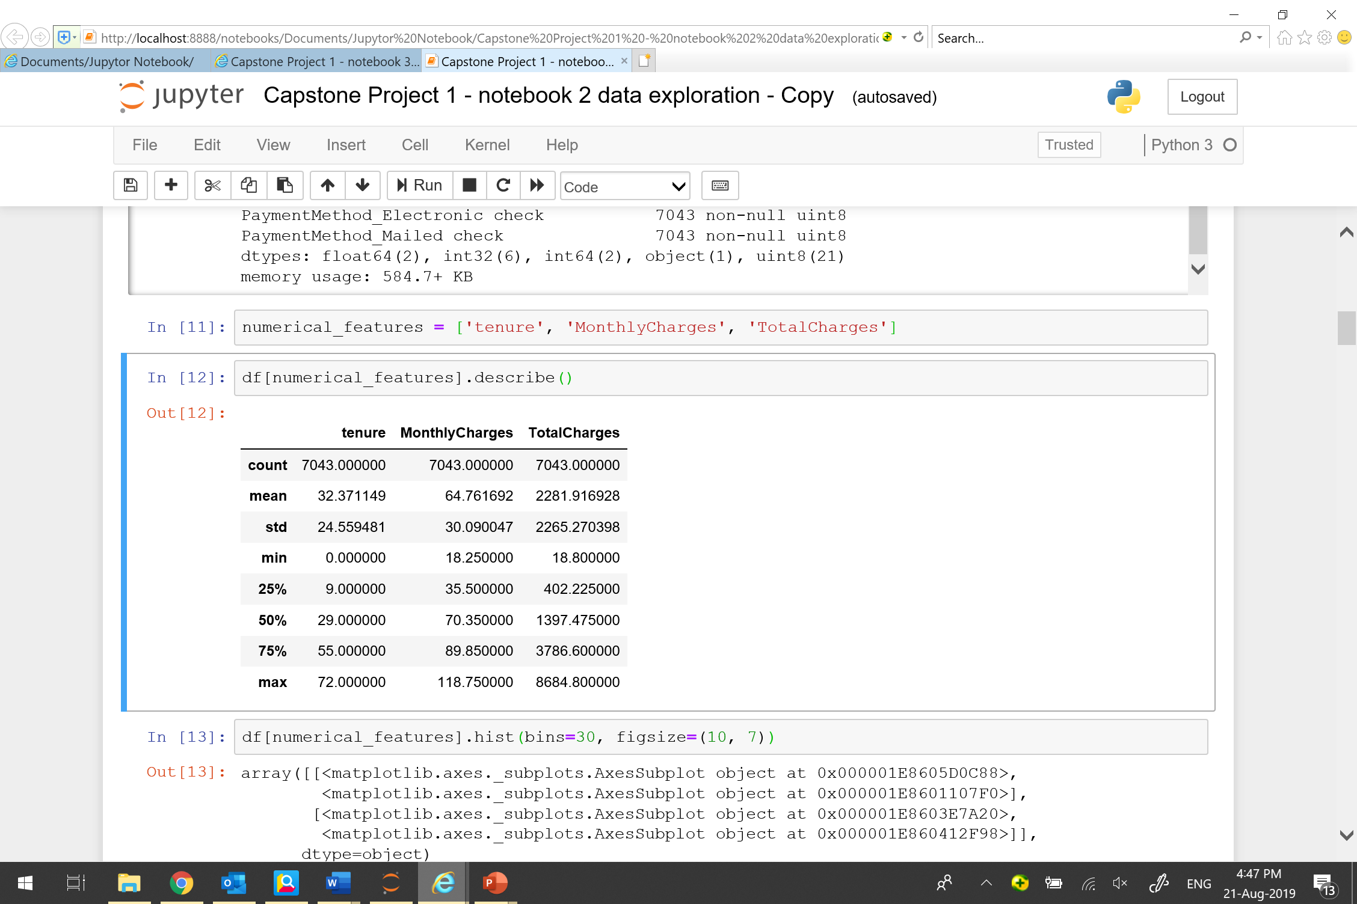
DATA EXPLORATION
Explore the statistics for continuous features

Slide 11
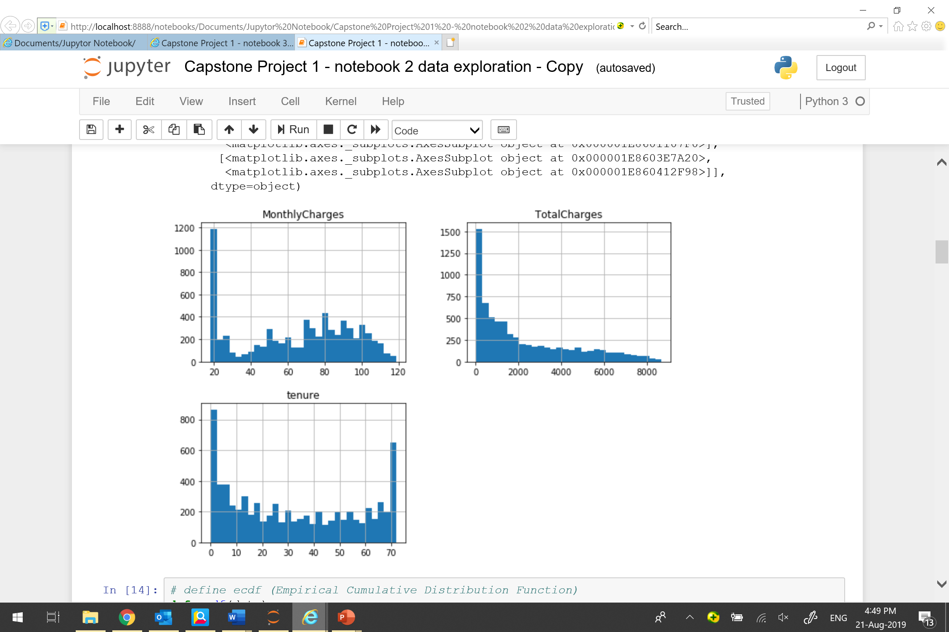
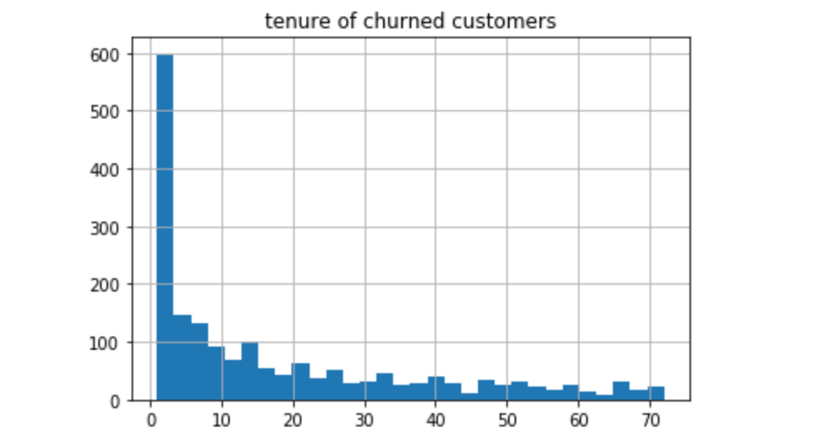
DATA EXPLORATION
Plot the histograms for continuous features
A lot of customers who churned actually did it in the first month;
2. Monthly charge about $20 has
the highest counts.

Slide 12
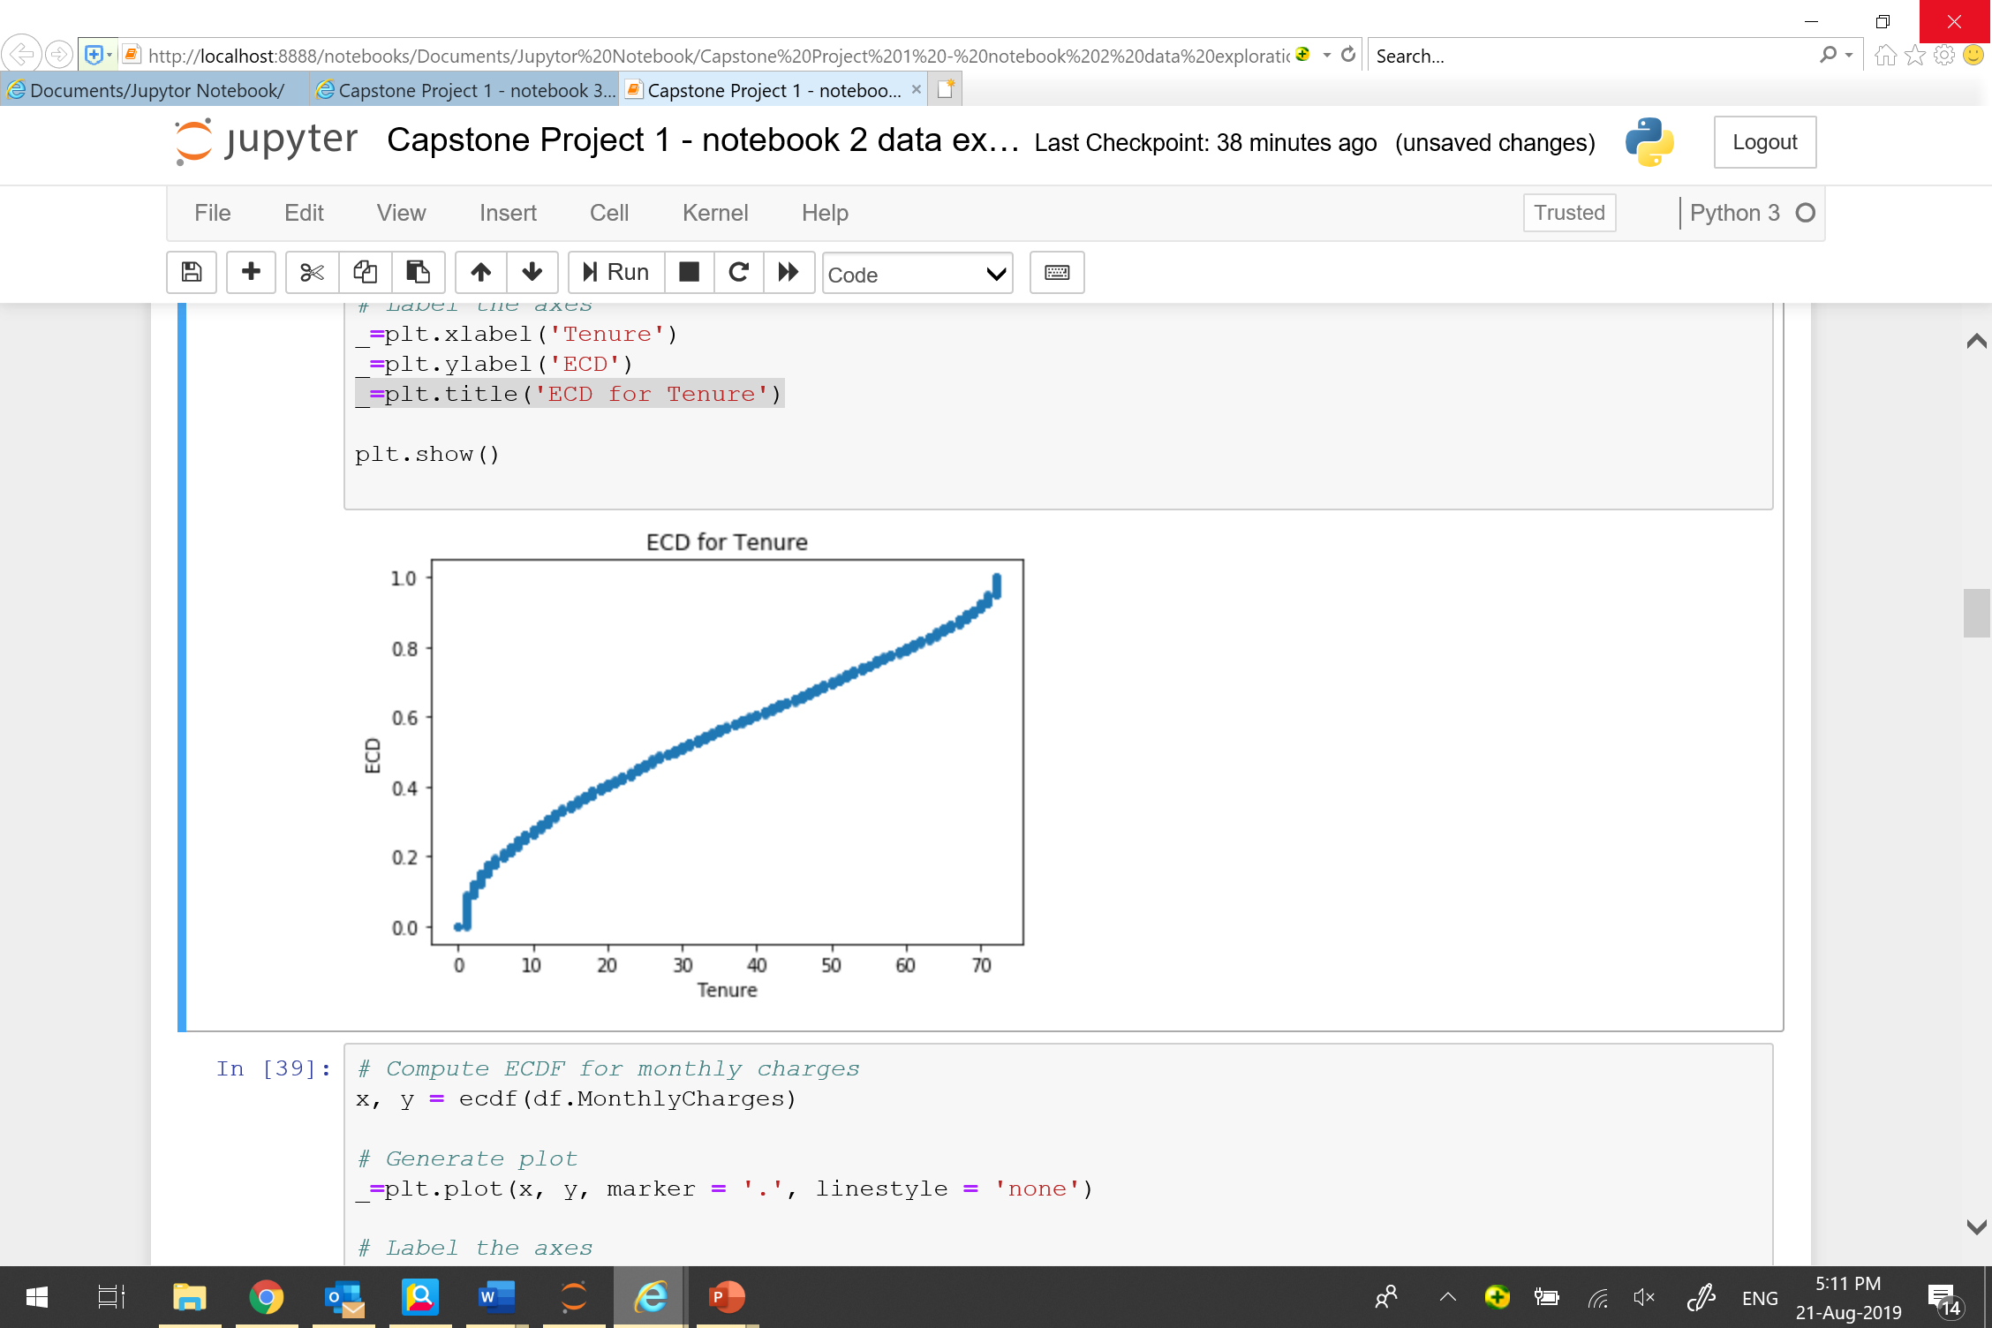
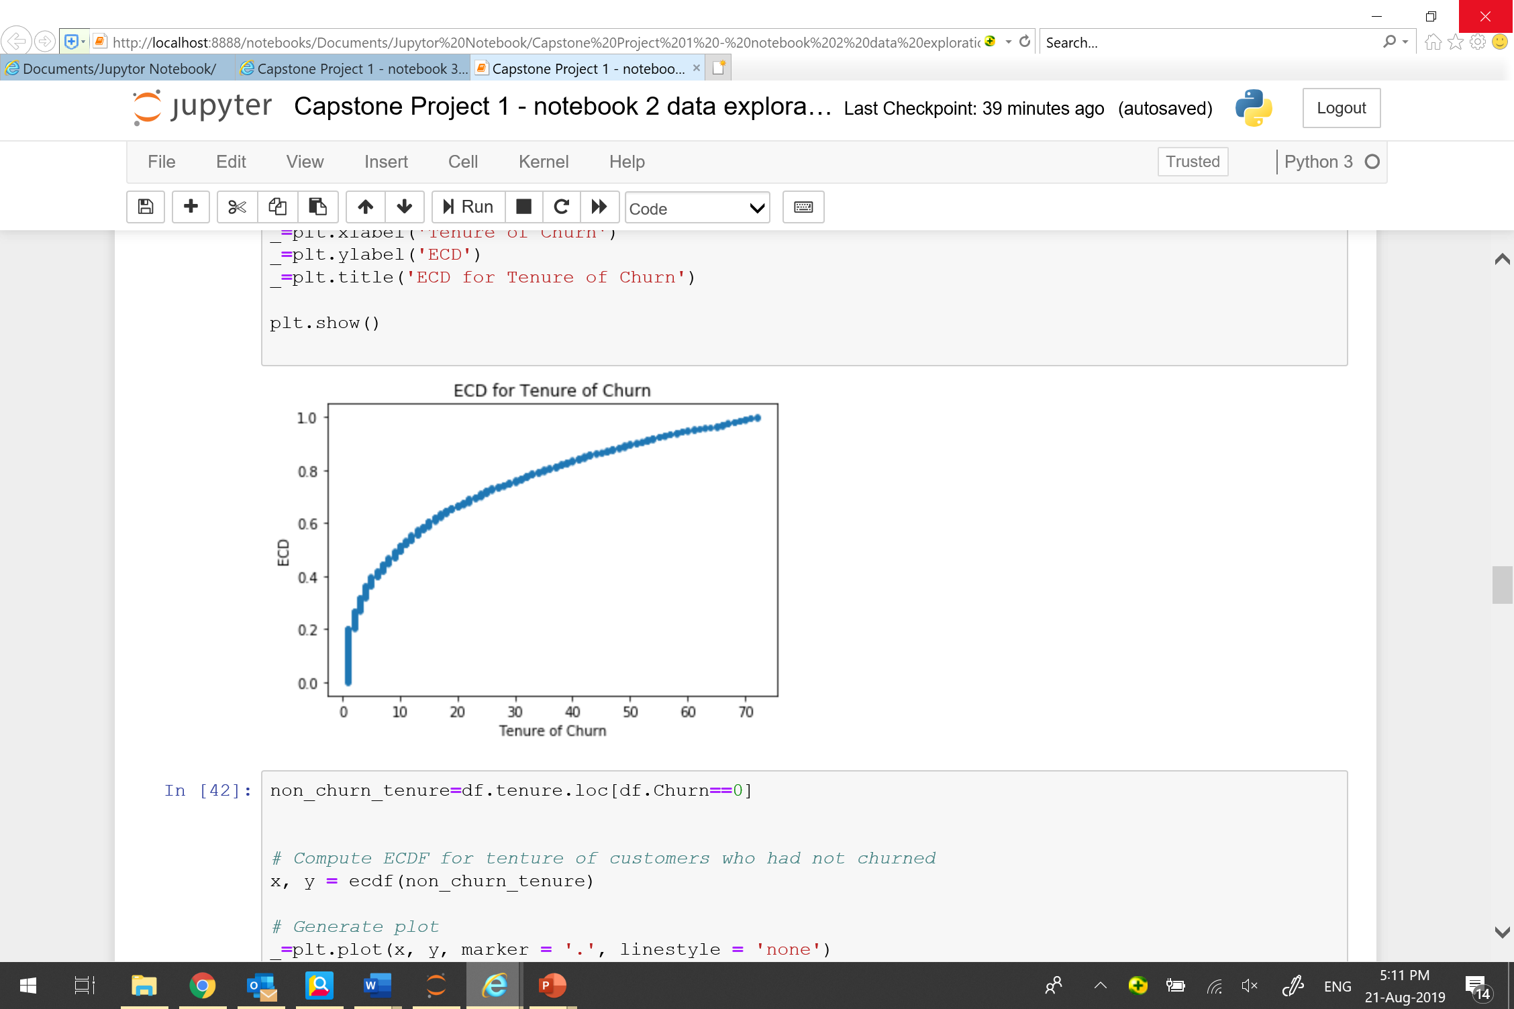
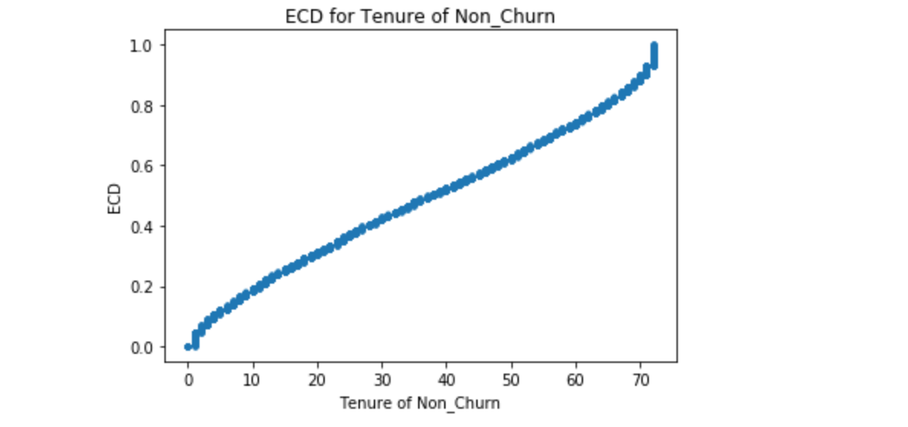
DATA EXPLORATION
Plot empirical cumulative distribution for tenure
80% of customers have tenure less than 60 months;
2. 80% of customers who had churned have tenure less than 40 months.

Slide 13
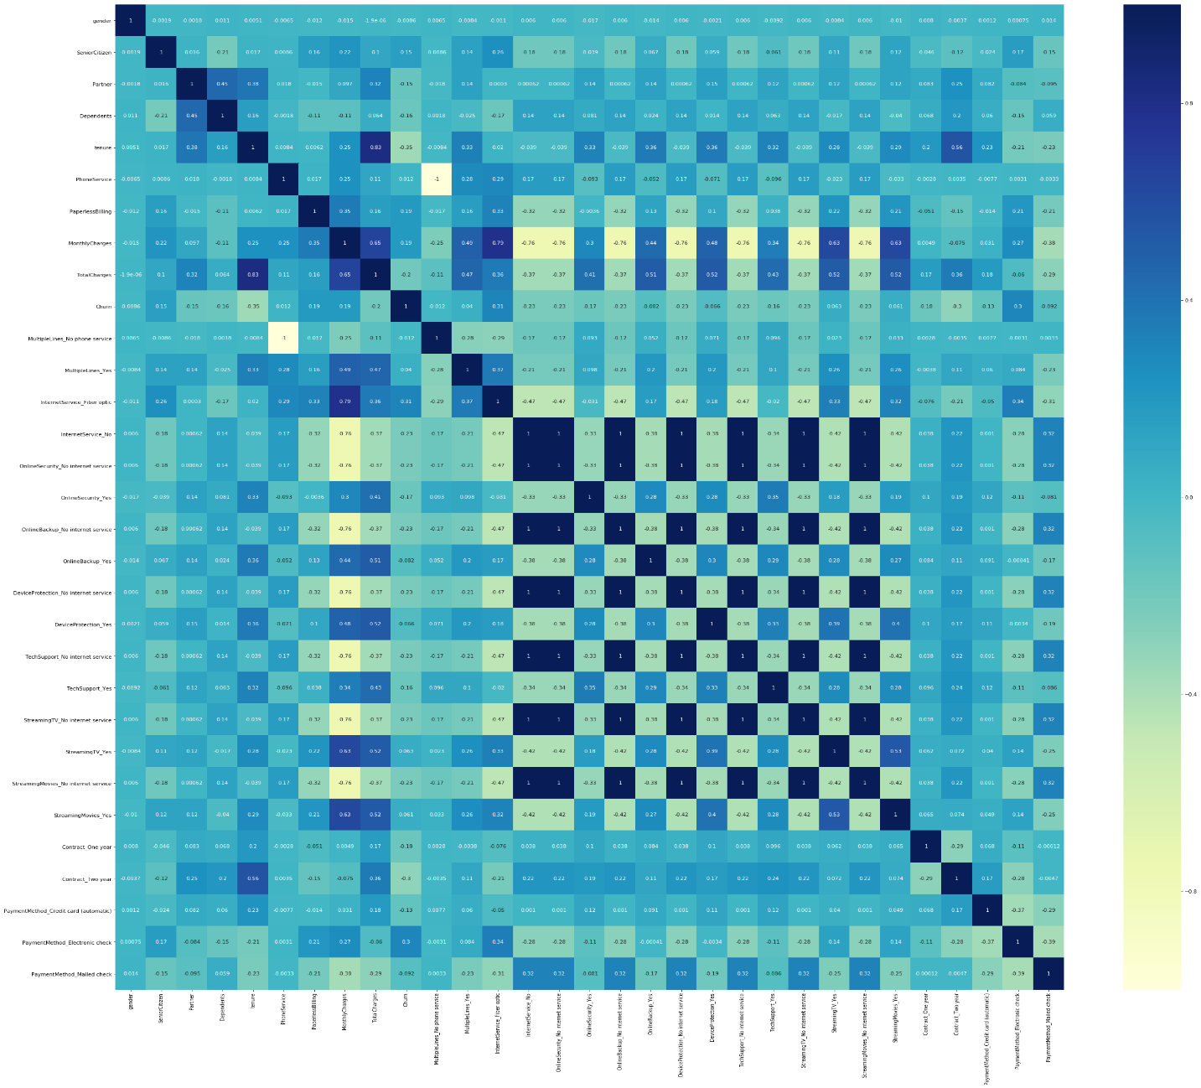
DATA EXPLORATION
Plot correlation heatmap to investigate the collinearity among features
Some features are strongly correlated

Slide 14
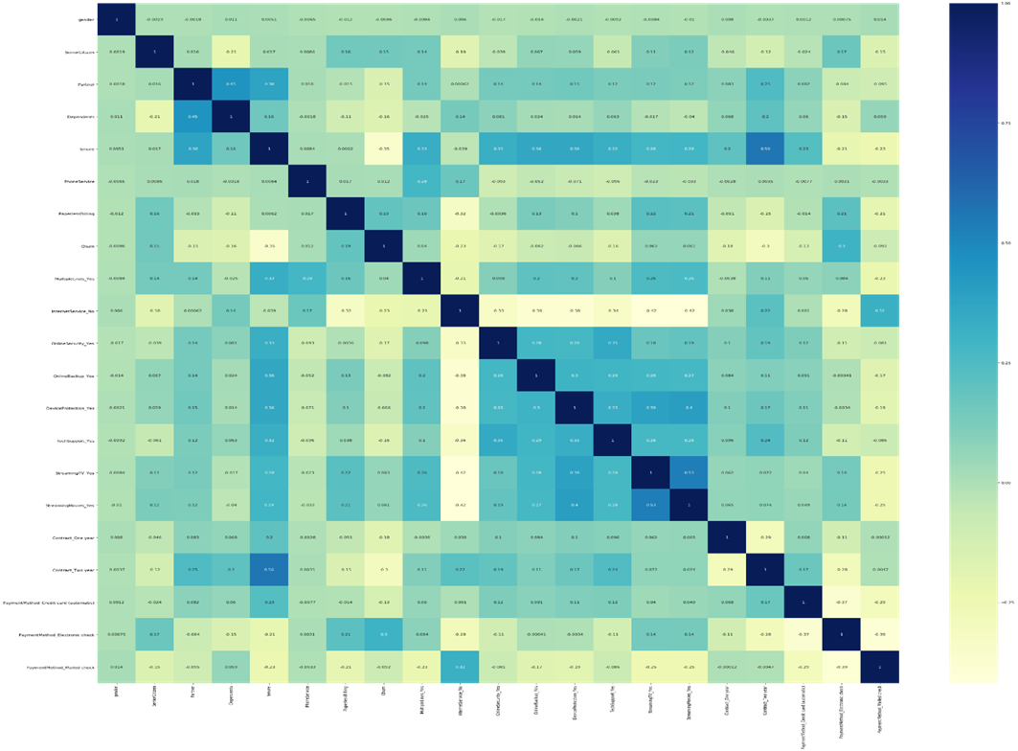
DATA EXPLORATION
Delete some collinear features and re-plot the correlation heatmap
Featured deleted:
['OnlineSecurity_No internet service','StreamingMovies_No internet service', 'OnlineBackup_No internet service','DeviceProtection_No internet service','TechSupport_No internet service','StreamingTV_No internet service','TotalCharges','InternetService_Fiber optic','MultipleLines_No phone service','MonthlyCharges']

Slide 15
04
Machine Learning

Slide 16
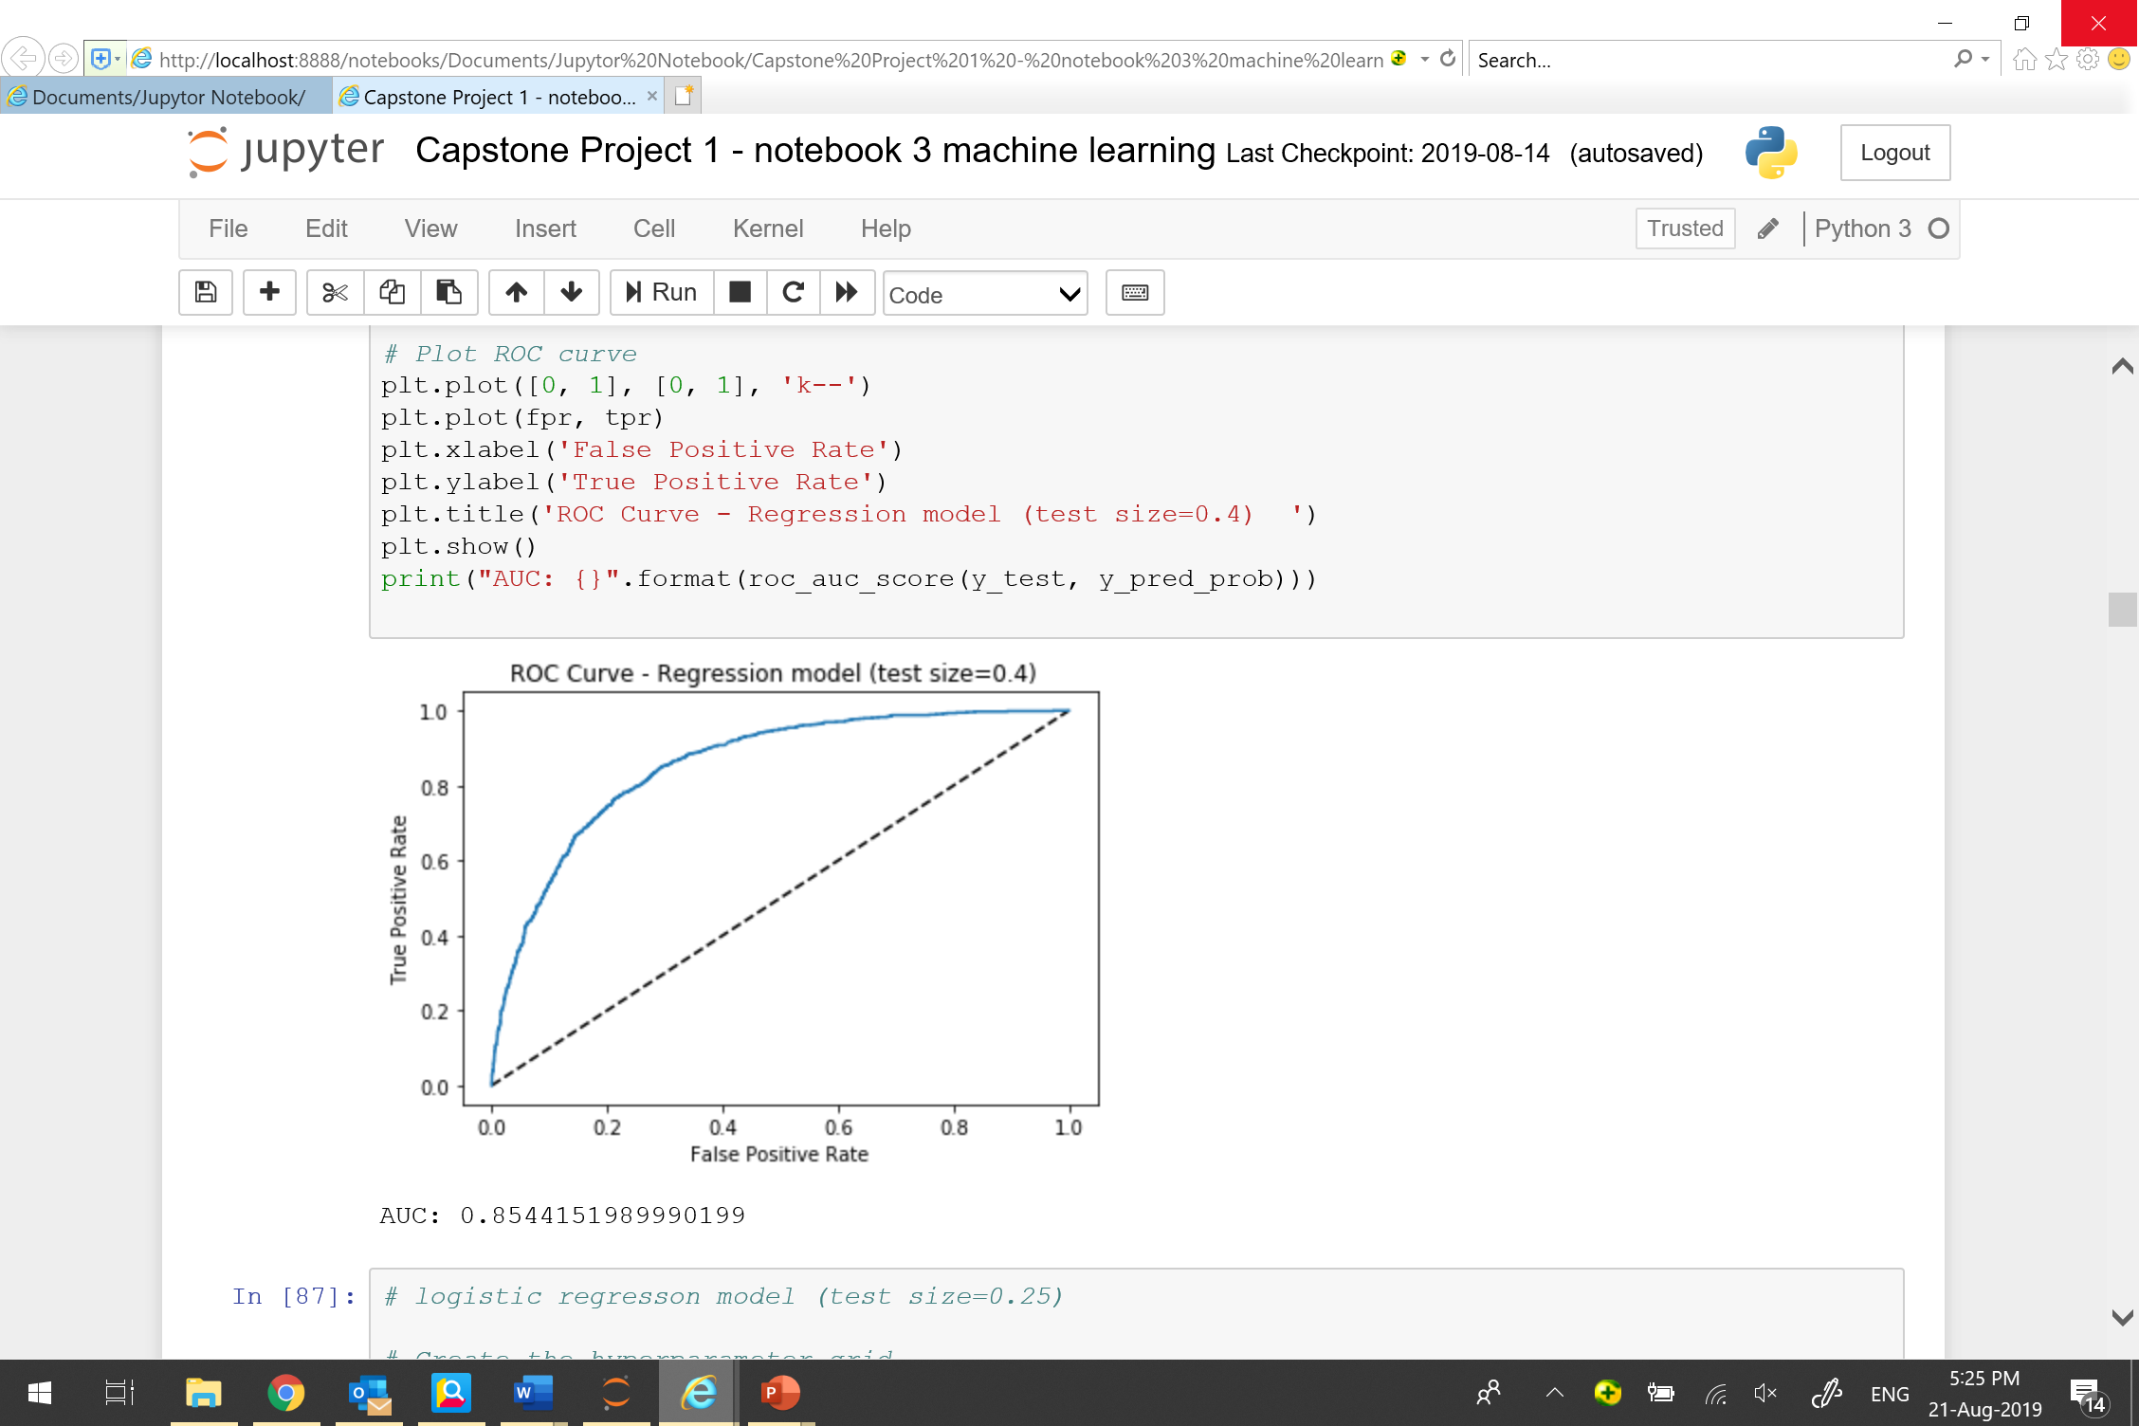
MACHINE LEARNING
BASE MODEL : LOGISTIC REGRESSION
Split dataset into training dataset (60%) and testing dataset (40%)
Create the hyperparameter grid
Use GridSearchCV method

Slide 17
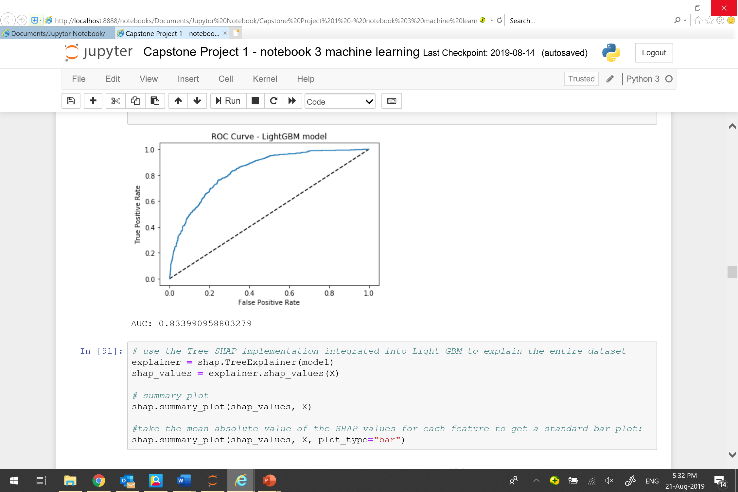
MACHINE LEARNING
GRADIENT BOOSTING MODEL
LightGBM model
Use default hyperparemeters
Training dataset (75%) and testing dataset (25%)

Slide 18
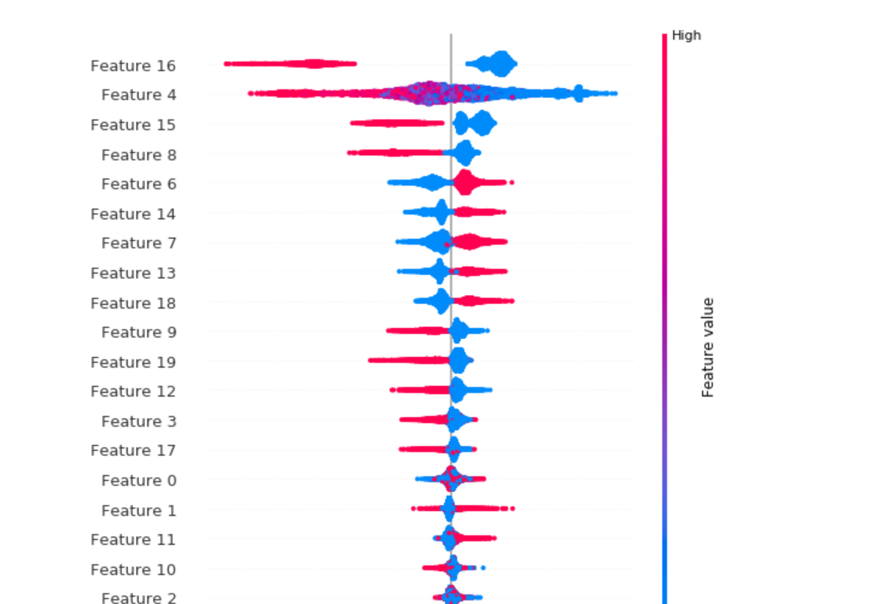
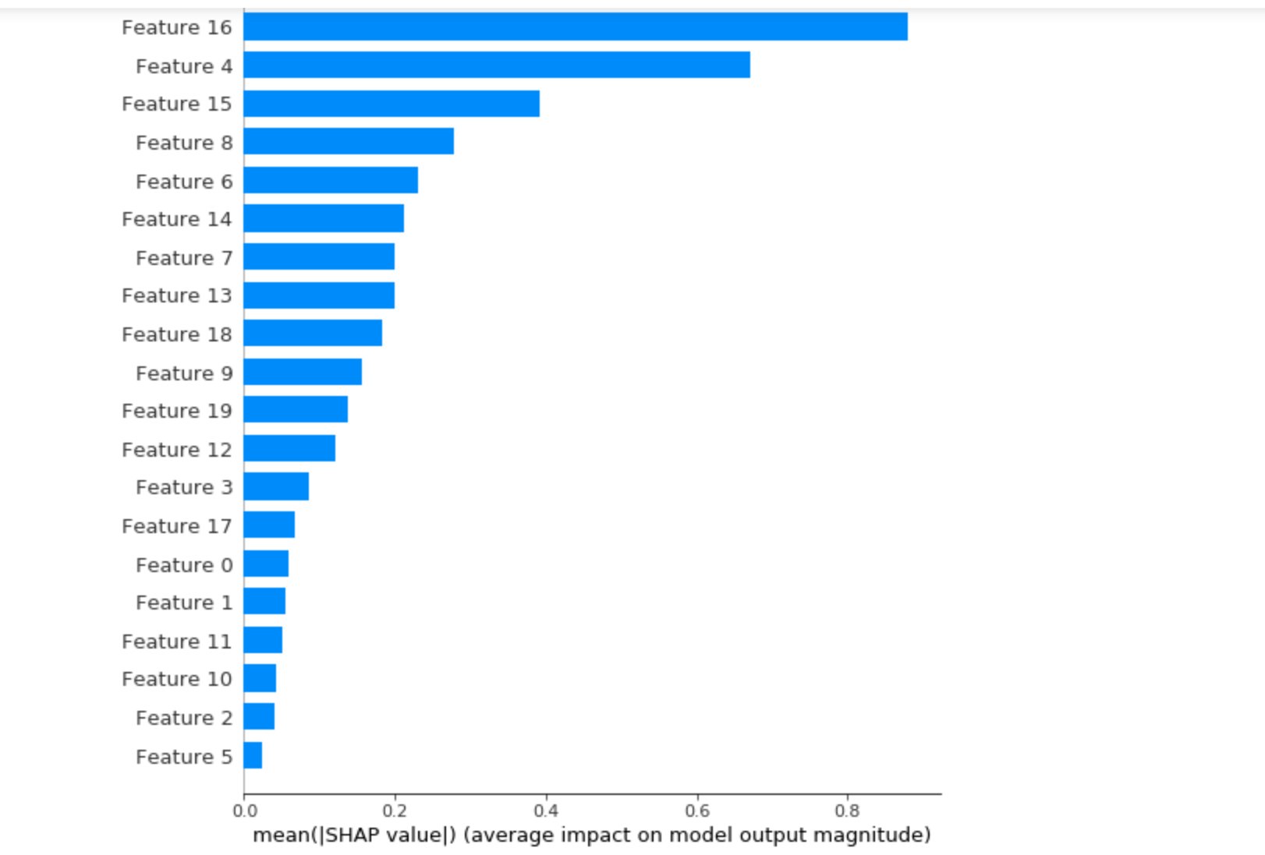
MACHINE LEARNING
FEATURE ANALYSIS
LightGBM model and shap
Explore the most important features that impact the output
16 Contract_Two year, 4 tenure , 15 Contract_One year

Slide 19
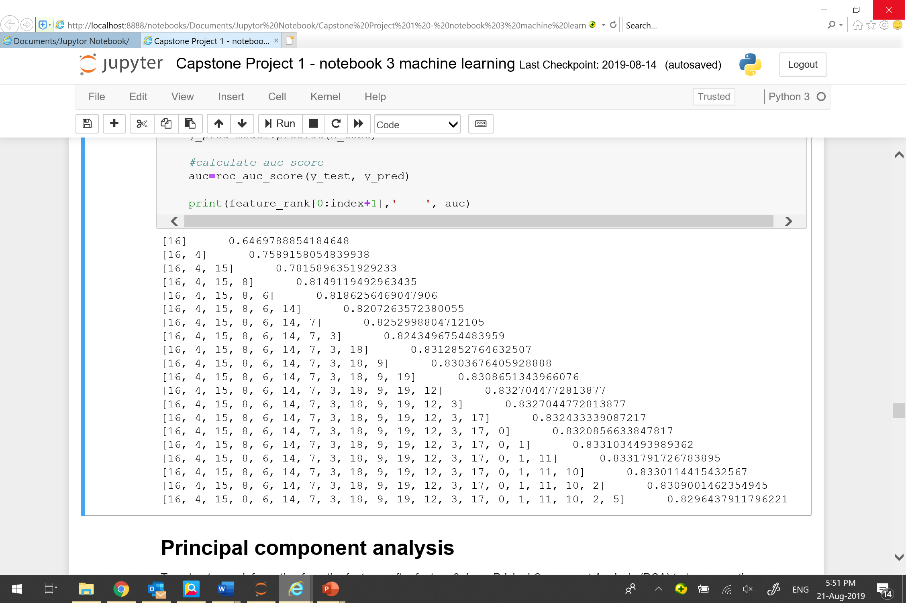
MACHINE LEARNING
FEATURE ANALYSIS
Determine which features carrying useful information
Add feature one by one to the LightGBM model in the descending order of importance

Slide 20
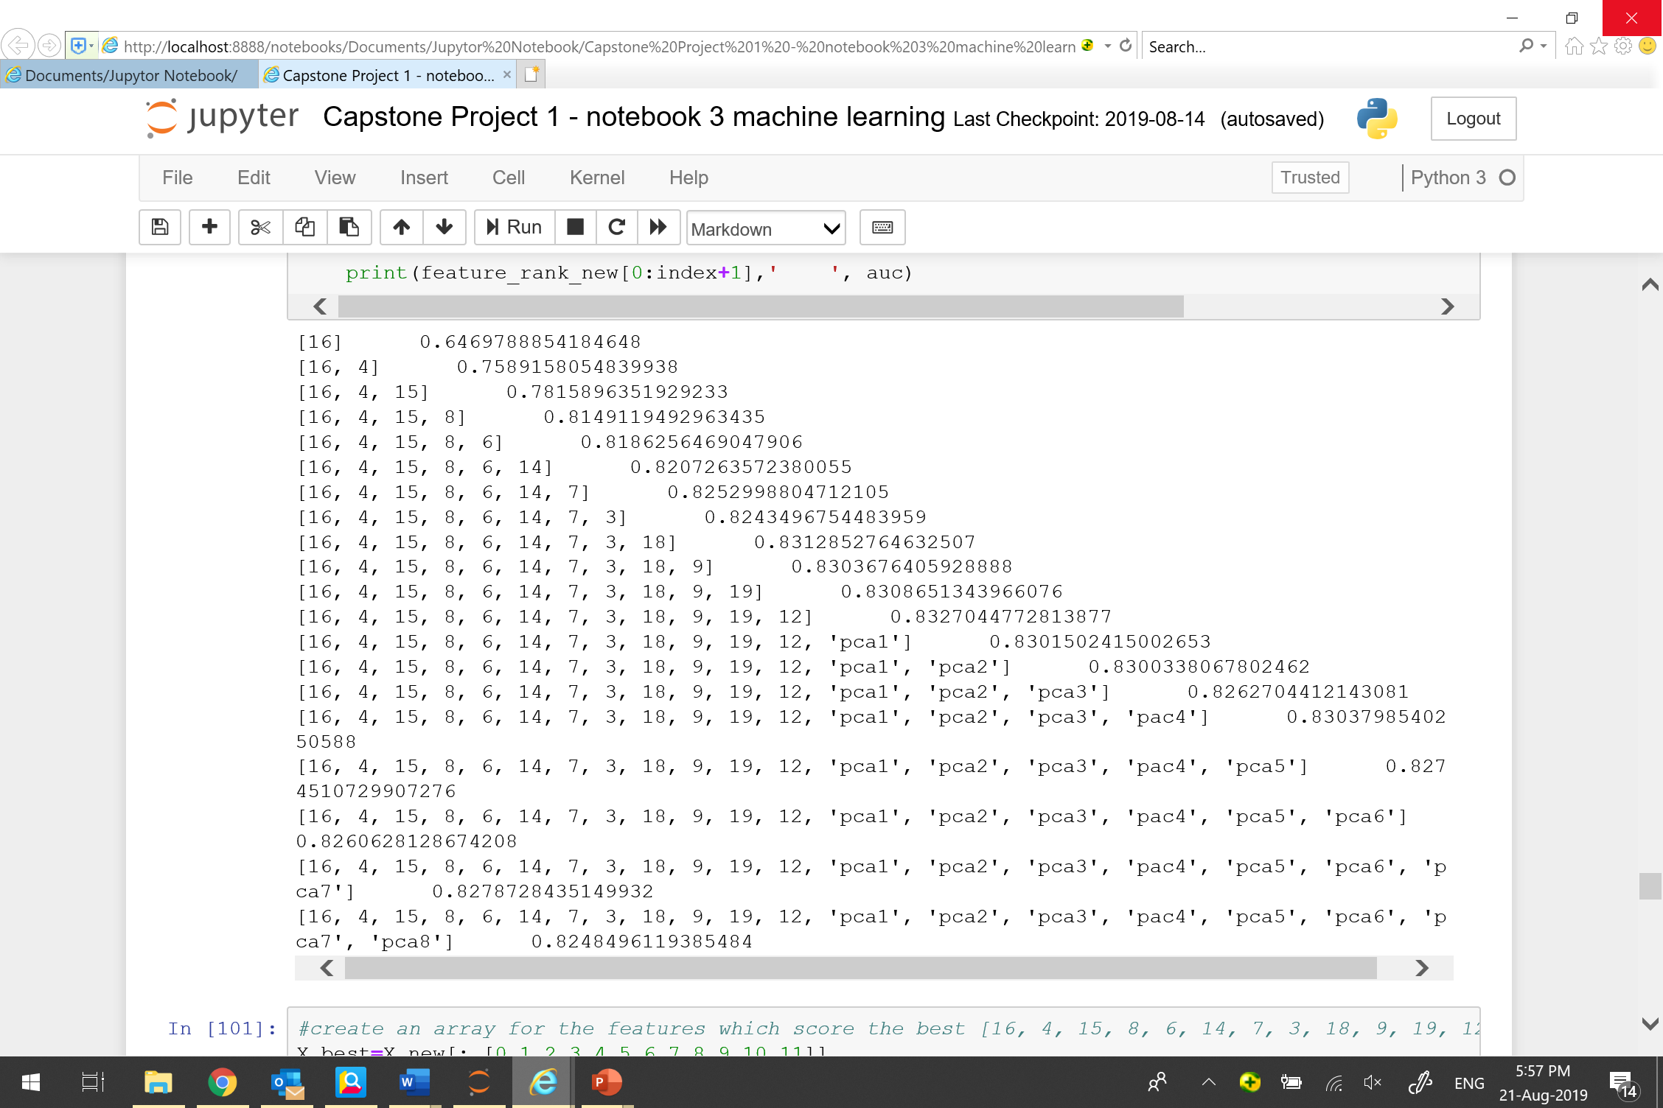
MACHINE LEARNING
PRINCIPAL COMPONENT ANALYSIS
Use PCA to transpose the features after feature 3
Add the“kept”and the transposed features one by one to LightGBM model

Slide 21
05
Conclusion

Slide 22
CONCLUSION
1. The most important features that influence the churn decision of customers are two-year contract and tenure.
2. Logistic regression model (with tuned hyperparameters) performs the best , AUC=0.8544
3. LightGBM model works fine with default hyperparameters, AUC=0.8339

Slide 23
THANK YOU

